Slide 1

Figure A.2.1 Standard drawing for an AND gate, OR gate, and an inverter, shown from
left to right. The signals to the left of each symbol are the inputs, while the output appears on the right. The
AND and OR gates both have two inputs. Inverters have a single input.
Copyright © 2021 Elsevier Inc. All rights reserved.

Slide 2

Figure A.2.2 Logic gate implementation of A + B using explicit inverts on the left and
bubbled inputs and outputs on the right. This logic function can be simplified to A B or in Verilog,
A & ~ B.
Copyright © 2021 Elsevier Inc. All rights reserved.

Slide 3
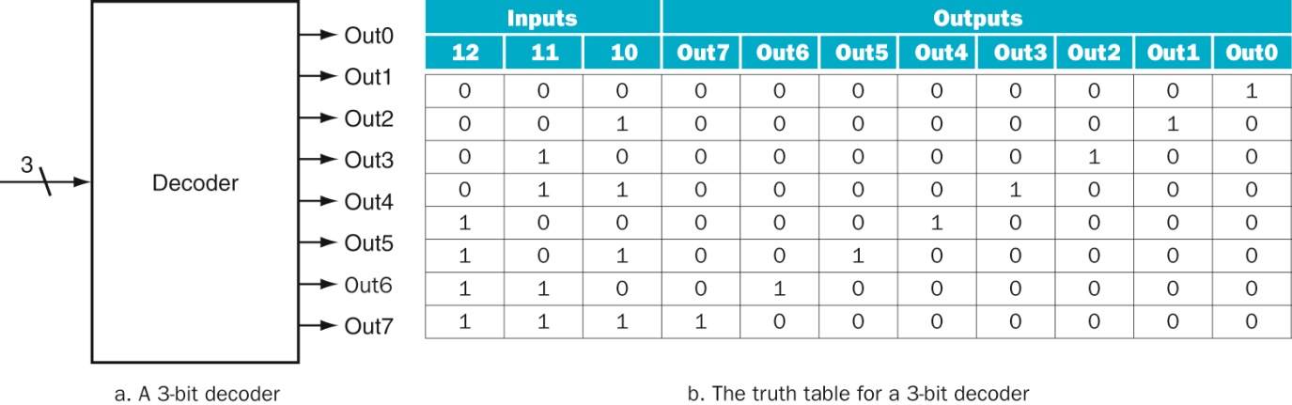
Figure A.3.1 A 3-bit decoder has three inputs, called 12, 11, and 10, and 23 = 8 outputs, called Out0 to Out7. Only the
output corresponding to the binary value of the input is true, as shown in the truth table. The label 3 on the input to the decoder says that the input signal is 3 bits wide.
Copyright © 2021 Elsevier Inc. All rights reserved.

Slide 4
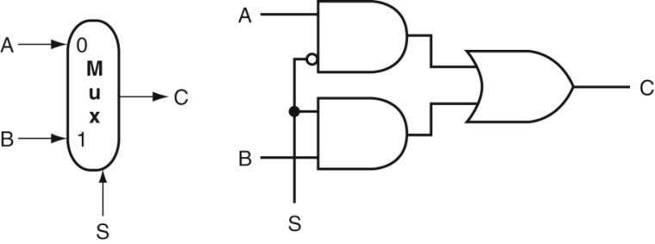
Figure A.3.2 A two-input multiplexor on the left and its implementation with gates on
the right. The multiplexor has two data inputs (A and B), which are labeled 0 and 1, and one selector input
(S), as well as an output C. Implementing multiplexors in Verilog requires a little more work, especially when
they are wider than two inputs. We show how to do this beginning on page A-23.
Copyright © 2021 Elsevier Inc. All rights reserved.

Slide 5
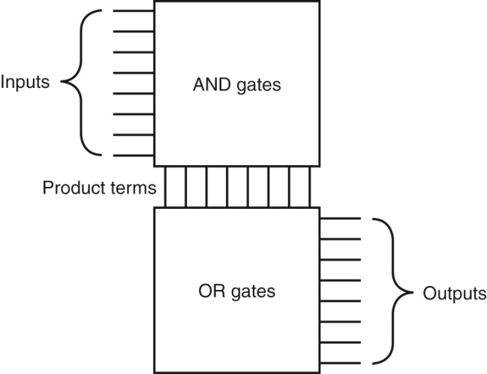
Figure A.3.3 The basic form of a PLA consists of an array of AND gates followed by an
array of OR gates. Each entry in the AND gate array is a product term consisting of any number of inputs or
inverted inputs. Each entry in the OR gate array is a sum term consisting of any number of these product terms.
Copyright © 2021 Elsevier Inc. All rights reserved.

Slide 6
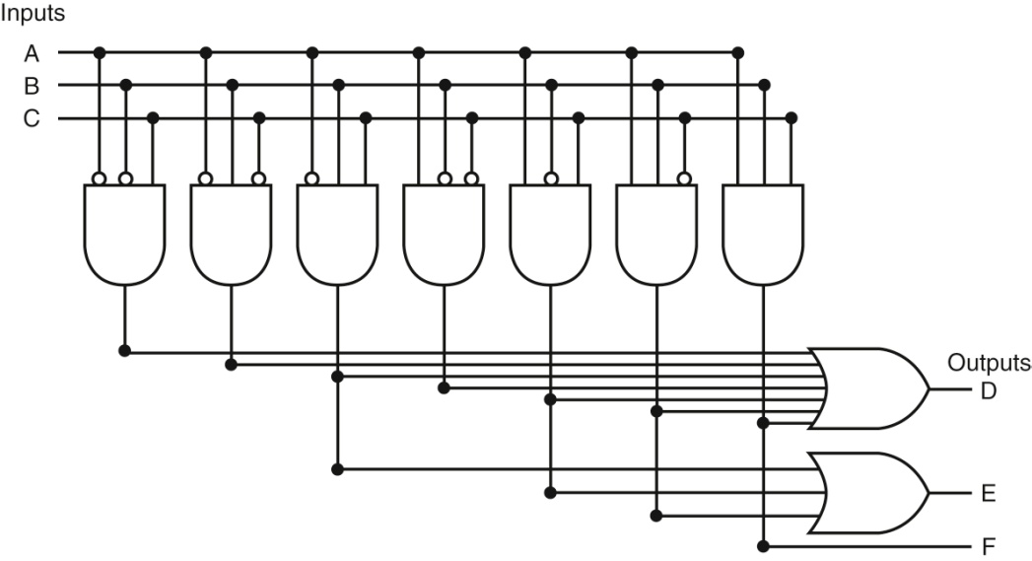
Figure A.3.4 The PLA for implementing the logic function described in the example.
Copyright © 2021 Elsevier Inc. All rights reserved.

Slide 7
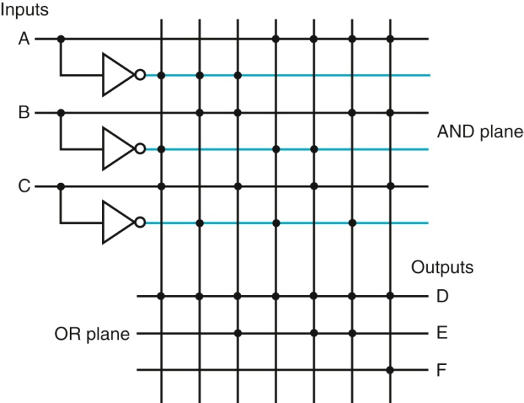
Figure A.3.5 A PLA drawn using dots to indicate the components of the product terms
and sum terms in the array. Rather than use inverters on the gates, usually all the inputs are run the
width of the AND plane in both true and complement forms. A dot in the AND plane indicates that the
input, or its inverse, occurs in the product term. A dot in the OR plane indicates that the corresponding
product term appears in the corresponding output.
Copyright © 2021 Elsevier Inc. All rights reserved.

Slide 8
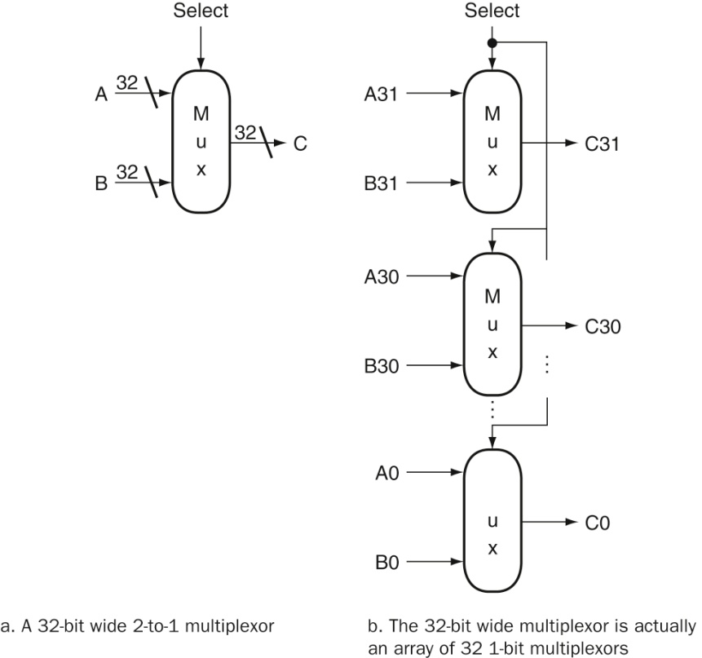
Figure A.3.6 A multiplexor is arrayed 64 times to perform a selection between two
64-bit inputs. Note that there is still only one data selection signal used for all 32 1-bit multiplexors.
Copyright © 2021 Elsevier Inc. All rights reserved.

Slide 9
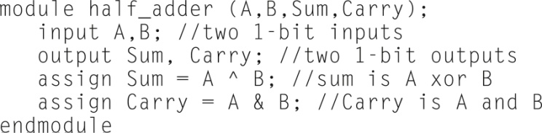
Figure A.4.1 A Verilog module that defines a half-adder using continuous assignments.
Copyright © 2021 Elsevier Inc. All rights reserved.

Slide 10
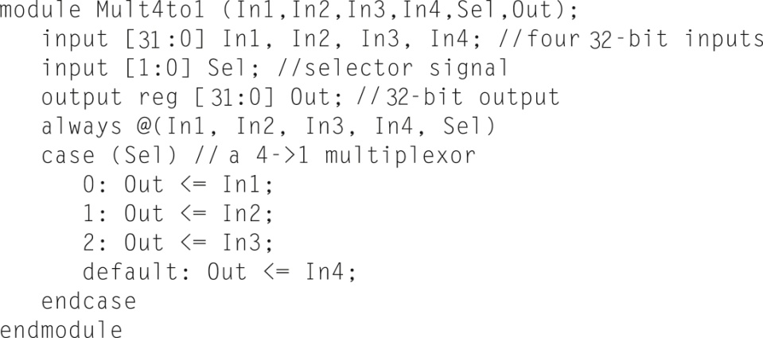
Figure A.4.2 A Verilog definition of a 4-to-1 multiplexor with 32-bit inputs, using a case
statement. The case statement acts like a C switch statement, except that in Verilog only the code
associated with the selected case is executed (as if each case state had a break at the end) and there is no
fall-through to the next statement.
Copyright © 2021 Elsevier Inc. All rights reserved.

Slide 11
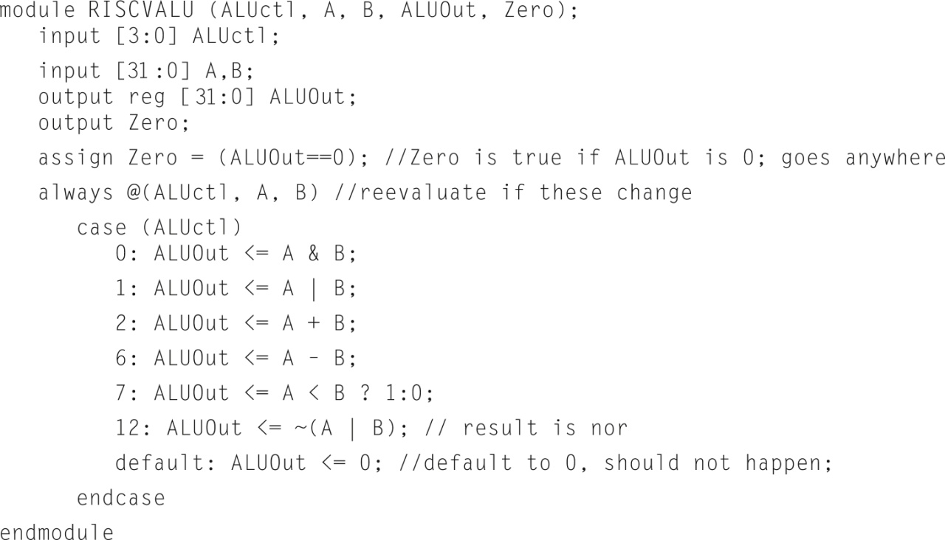
Figure A.4.3 A Verilog behavioral definition of a RISC-V ALU. This could be synthesized using a module library containing basic arithmetic and logical operations.
Copyright © 2021 Elsevier Inc. All rights reserved.

Slide 12
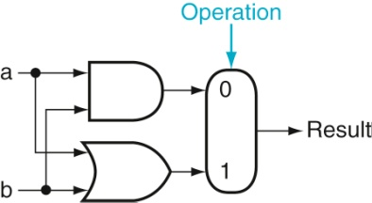
Figure A.5.1 The 1-bit logical unit for AND and OR.
Copyright © 2021 Elsevier Inc. All rights reserved.

Slide 13
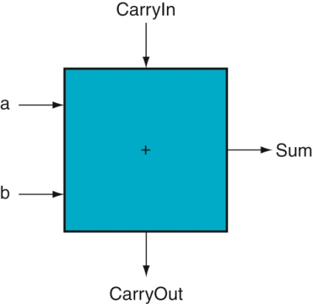
Figure A.5.2 A 1-bit adder. This adder is called a full adder; it is also called a (3,2) adder because it
has three inputs and two outputs. An adder with only the a and b inputs is called a (2,2) adder or half-adder.
Copyright © 2021 Elsevier Inc. All rights reserved.

Slide 14
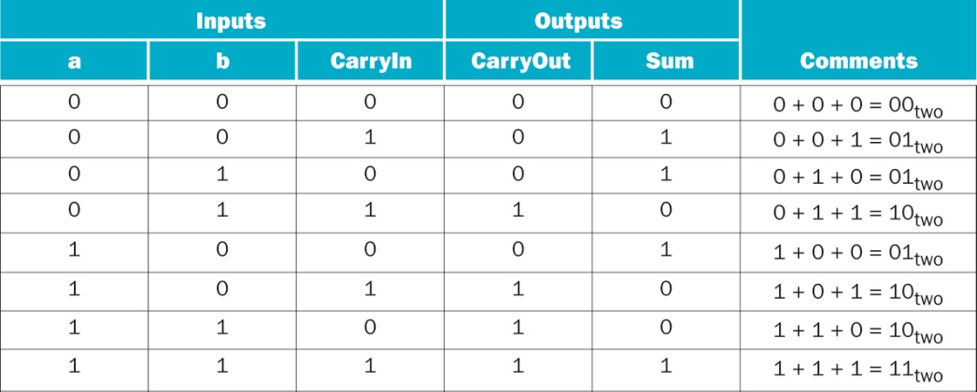
Figure A.5.3 Input and output specification for a 1-bit adder.
Copyright © 2021 Elsevier Inc. All rights reserved.

Slide 15
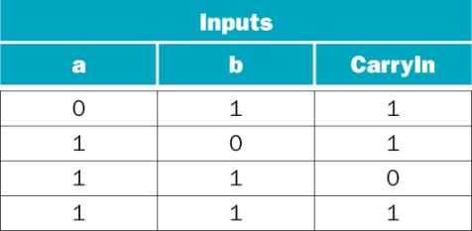
Figure A.5.4 Values of the inputs when CarryOut is a 1.
Copyright © 2021 Elsevier Inc. All rights reserved.

Slide 16
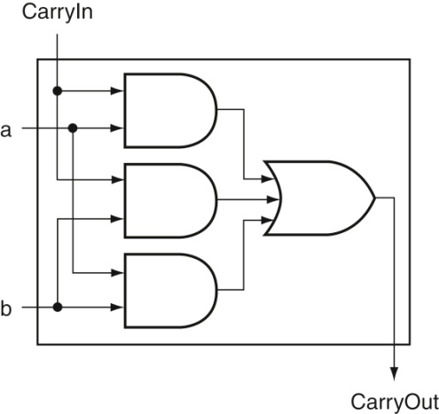
Figure A.5.5 Adder hardware for the CarryOut signal. The rest of the adder hardware is the logic
for the Sum output given in the equation on this page.
Copyright © 2021 Elsevier Inc. All rights reserved.

Slide 17
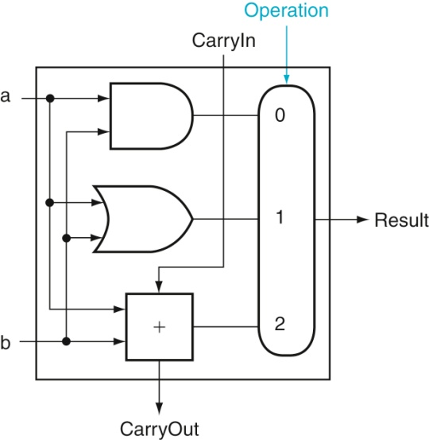
Figure A.5.6 A 1-bit ALU that performs AND, OR, and addition (see Figure A.5.5).
Copyright © 2021 Elsevier Inc. All rights reserved.

Slide 18
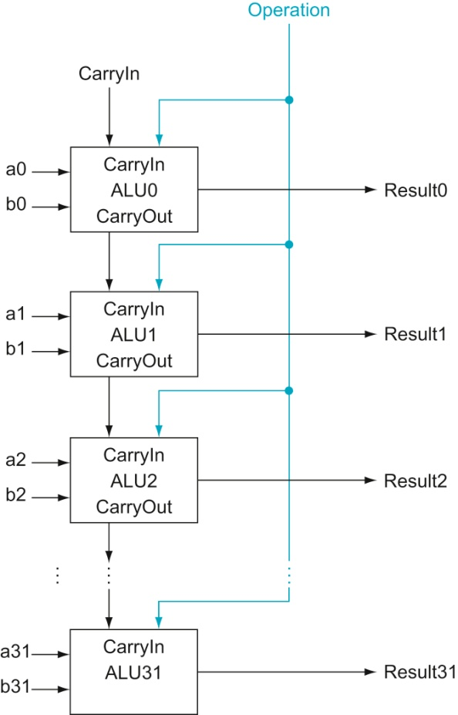
Figure A.5.7 A 32-bit ALU constructed from 32 1-bit ALUs. CarryOut of the less significant bit
is connected to the CarryIn of the more significant bit. This organization is called ripple carry.
Copyright © 2021 Elsevier Inc. All rights reserved.

Slide 19
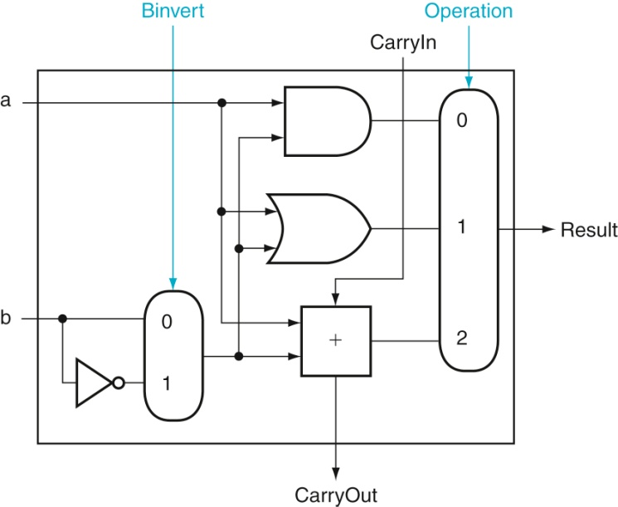
Figure A.5.8 A 1-bit ALU that performs AND, OR, and addition on a and b or a and b. By
selecting b (Binvert = 1) and setting CarryIn to 1 in the least significant bit of the ALU, we get two’s complement
subtraction of b from a instead of addition of b to a.
Copyright © 2021 Elsevier Inc. All rights reserved.

Slide 20
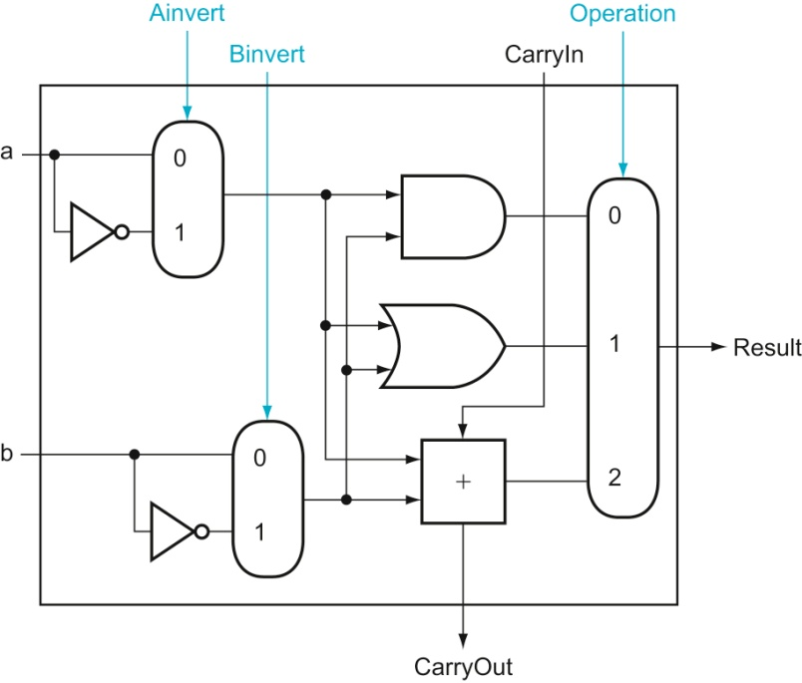
Figure A.5.9 A 1-bit ALU that performs AND, OR, and addition on a and b or a
and b. By selecting a (Ainvert = 1) and b (Binvert = 1), we get a NOR b instead of a AND b.
Copyright © 2021 Elsevier Inc. All rights reserved.

Slide 21
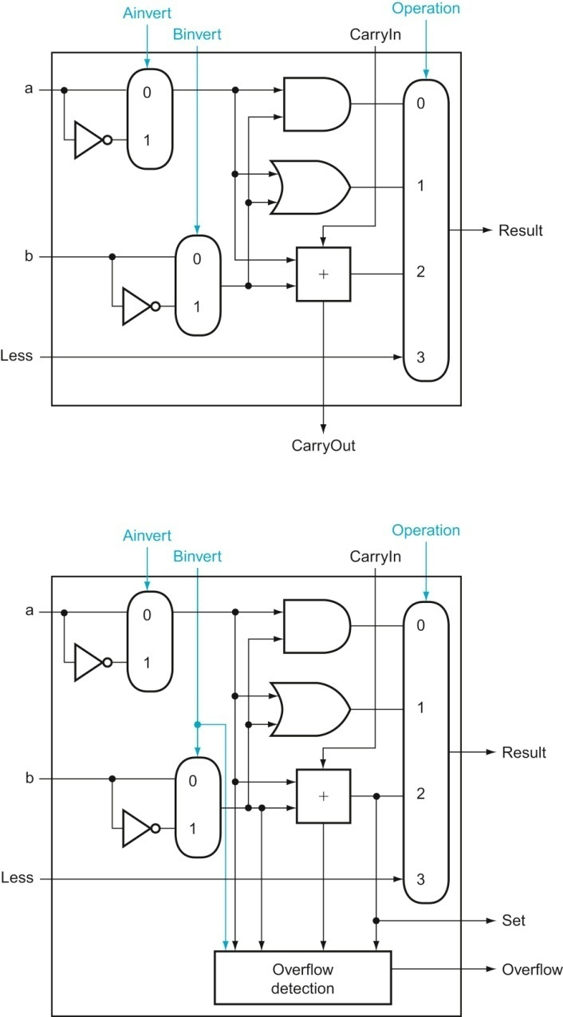
Figure A.5.10 (Top) A 1-bit ALU that performs AND, OR, and addition on a and b or b, and (bottom) a 1-bit ALU for the most significant bit. The top drawing includes a direct input that is connected to perform the set on less than operation (see Figure A.5.11); the bottom has a direct output from the adder for the less than comparison called Set. (See Exercise A.24 at the end of this appendix to see how to calculate overflow with fewer inputs.)
Copyright © 2021 Elsevier Inc. All rights reserved.

Slide 22
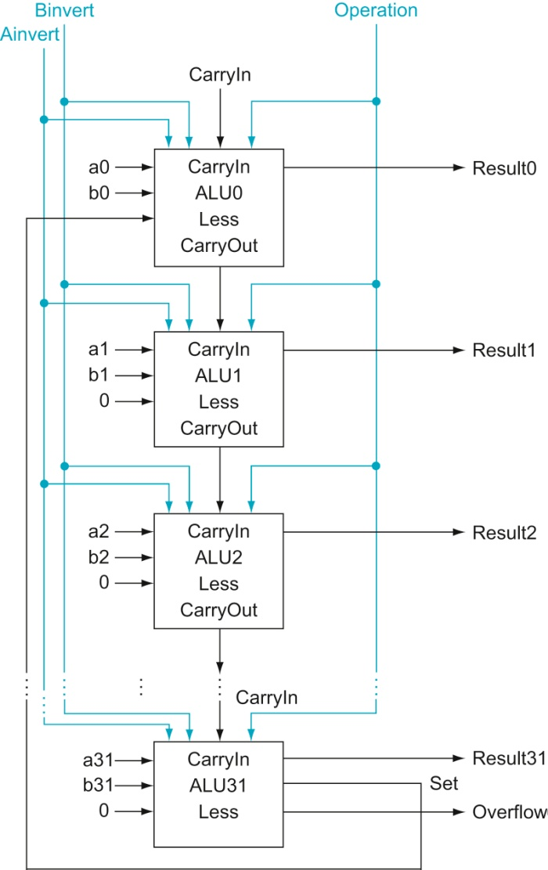
Figure A.5.11 A 32-bit ALU constructed from the 31 copies of the 1-bit ALU in the top of
Figure A.5.10 and one 1-bit ALU in the bottom of that figure. The Less inputs are connected to 0
except for the least significant bit, which is connected to the Set output of the most significant bit. If the ALU
performs a − b and we select the input 3 in the multiplexor in Figure A.5.10, then Result = 0 … 001 if a < b,
and Result = 0 … 000 otherwise.
Copyright © 2021 Elsevier Inc. All rights reserved.

Slide 23
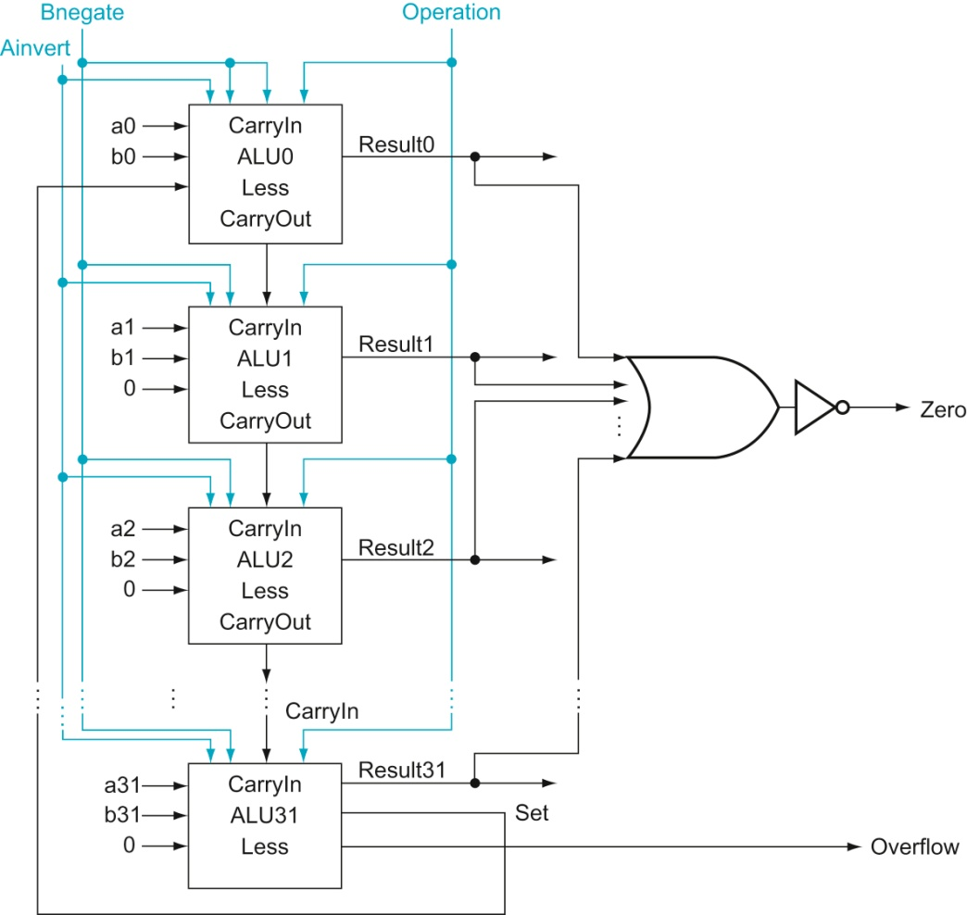
Figure A.5.12 The final 32-bit ALU. This adds a Zero detector to Figure A.5.11.
Copyright © 2021 Elsevier Inc. All rights reserved.

Slide 24
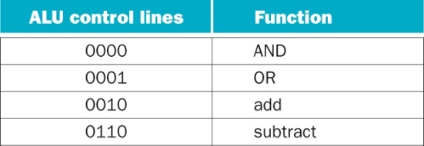
Figure A.5.13 The values of the three ALU control lines, Ainvert, Bnegate, and Operation,
and the corresponding ALU operations.
Copyright © 2021 Elsevier Inc. All rights reserved.

Slide 25
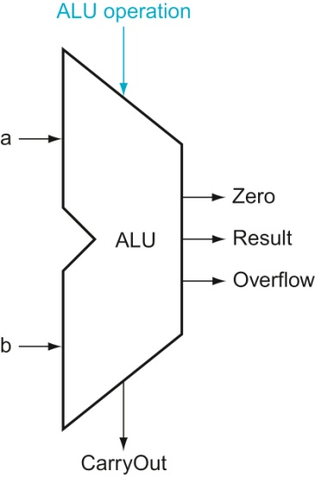
Figure A.5.14 The symbol commonly used to represent an ALU, as shown in Figure
A.5.12. This symbol is also used to represent an adder, so it is normally labeled either with ALU or Adder..
Copyright © 2021 Elsevier Inc. All rights reserved.

Slide 26
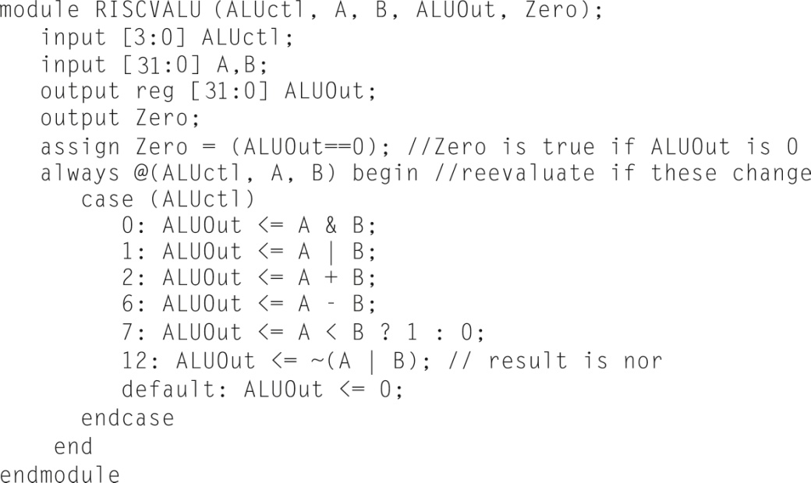
Figure A.5.15 A Verilog behavioral definition of a RISC-V ALU.
Copyright © 2021 Elsevier Inc. All rights reserved.

Slide 27
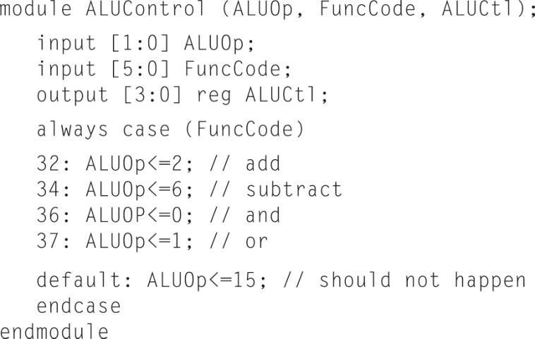
Figure A.5.16 The RISC-V ALU control: a simple piece of combinational control logic.
Copyright © 2021 Elsevier Inc. All rights reserved.

Slide 28
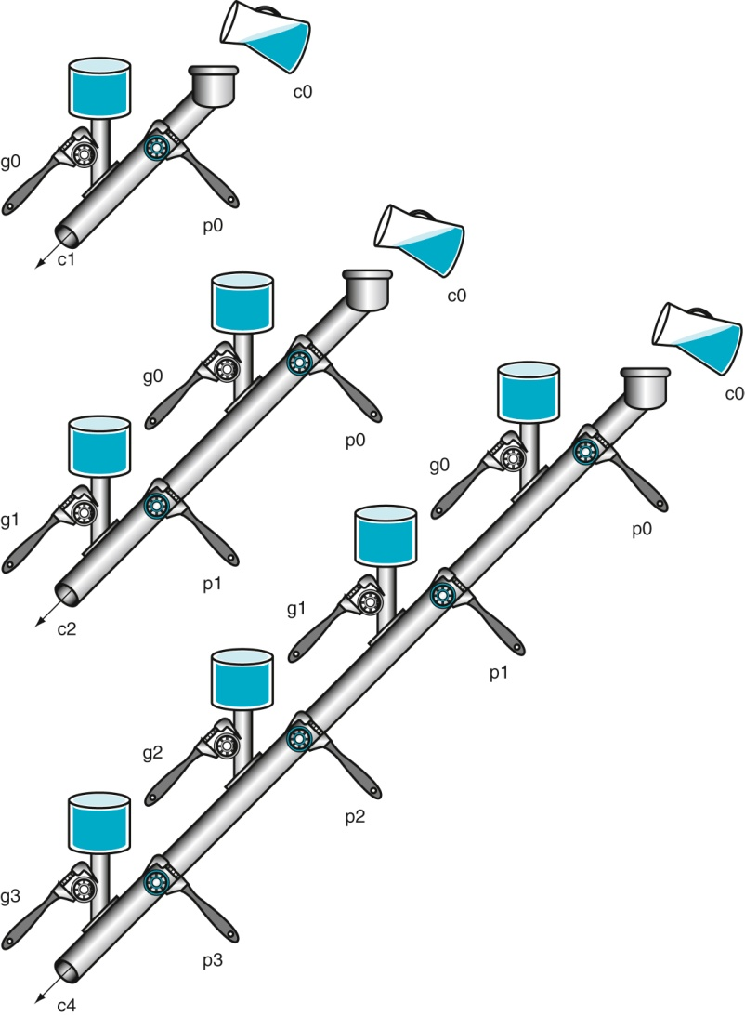
Figure A.6.1 A plumbing analogy for carry lookahead for 1 bit, 2 bits, and 4 bits using
water pipes and valves. The wrenches are turned to open and close valves. Water is shown in color. The
output of the pipe (ci + 1) will be full if either the nearest generate value (gi) is turned on or if the i propagate
value (pi) is on and there is water further upstream, either from an earlier generate or a propagate with water
behind it. CarryIn (c0) can result in a carry out without the help of any generates, but with the help of all
propagates.
Copyright © 2021 Elsevier Inc. All rights reserved.

Slide 29
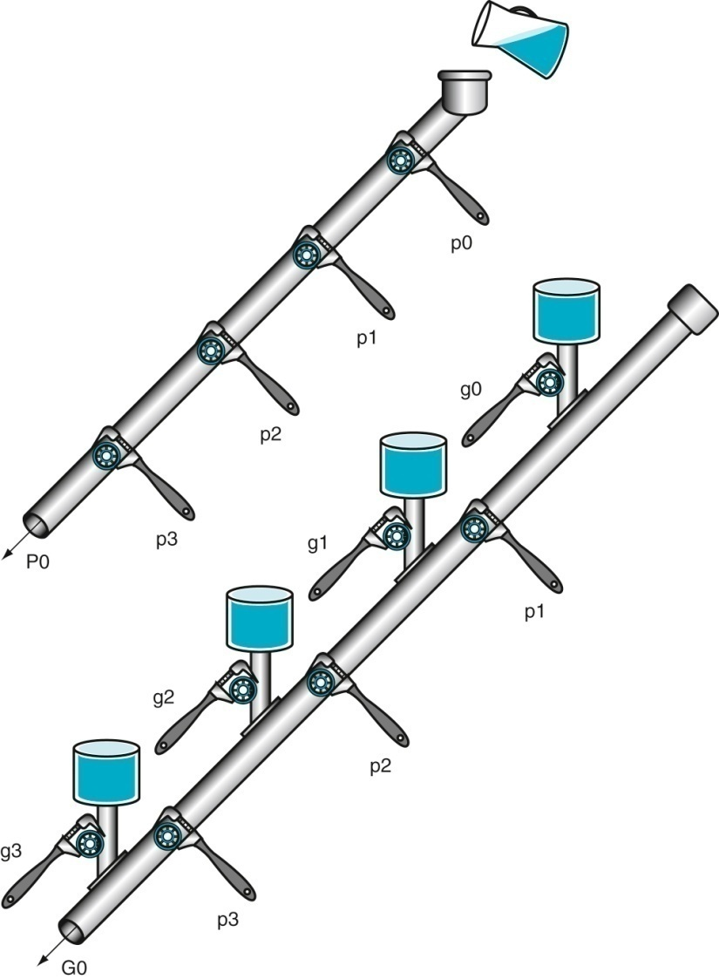
Figure A.6.2 A plumbing analogy for the next-level carry-lookahead signals P0 and G0.
P0 is open only if all four propagates (pi) are open, while water flows in G0 only if at least one generate (gi) is
open and all the propagates downstream from that generate are open.
Copyright © 2021 Elsevier Inc. All rights reserved.

Slide 30
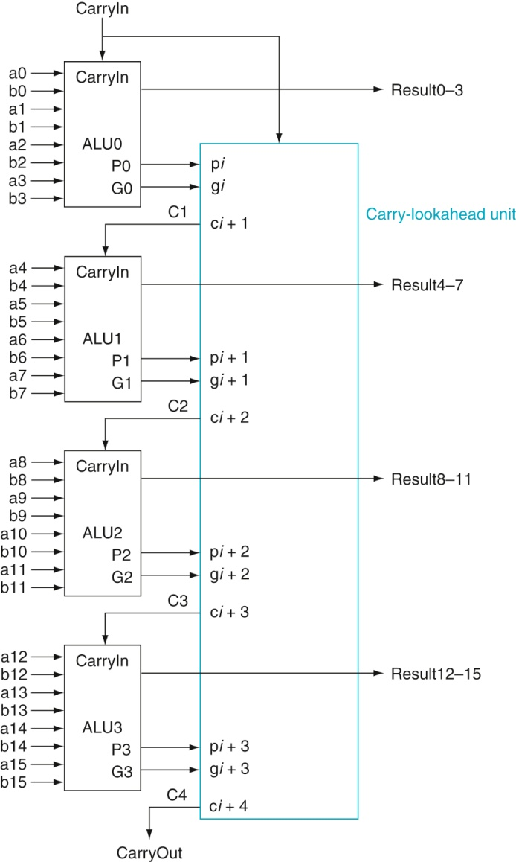
Figure A.6.3 Four 4-bit ALUs using carry lookahead to form a 16-bit adder. Note that the
carries come from the carry-lookahead unit, not from the 4-bit ALUs.
Copyright © 2021 Elsevier Inc. All rights reserved.

Slide 31
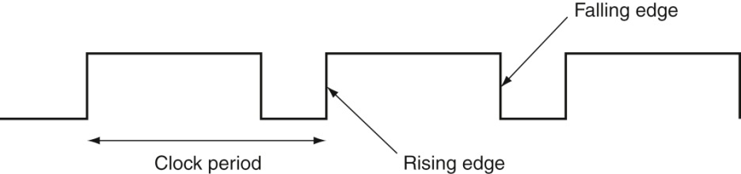
Figure A.7.1 A clock signal oscillates between high and low values. The clock period is the
time for one full cycle. In an edge-triggered design, either the rising or falling edge of the clock is active and
causes state to be changed.
Copyright © 2021 Elsevier Inc. All rights reserved.

Slide 32
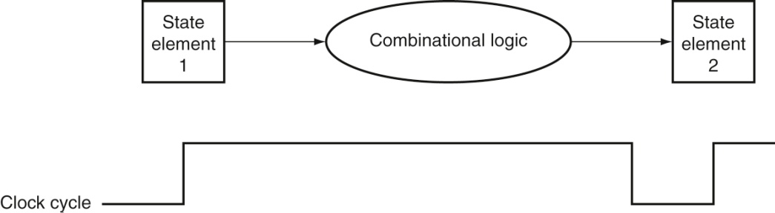
Figure A.7.2 The inputs to a combinational logic block come from a state element, and
the outputs are written into a state element. The clock edge determines when the contents of the
state elements are updated.
Copyright © 2021 Elsevier Inc. All rights reserved.

Slide 33
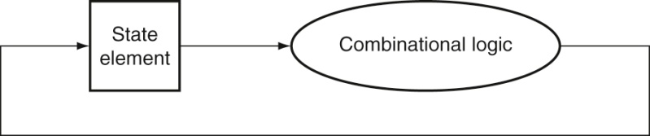
Figure A.7.3 An edge-triggered methodology allows a state element to be read and
written in the same clock cycle without creating a race that could lead to undetermined
data values. Of course, the clock cycle must still be long enough so that the input values are stable when
the active clock edge occurs.
Copyright © 2021 Elsevier Inc. All rights reserved.

Slide 34
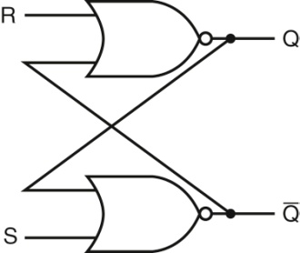
Figure A.8.1 A pair of cross-coupled NOR gates can store an internal value. The value
stored on the output Q is recycled by inverting it to obtain Q and then inverting Q to obtain Q. If either R or
Q is asserted, Q will be deasserted and vice versa.
Copyright © 2021 Elsevier Inc. All rights reserved.

Slide 35
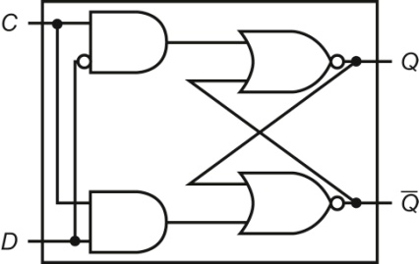
Figure A.8.2 A D latch implemented with NOR gates. A NOR gate acts as an inverter if the other
input is 0. Thus, the cross-coupled pair of NOR gates acts to store the state value unless the clock input, C, is
asserted, in which case the value of input D replaces the value of Q and is stored. The value of input D must
be stable when the clock signal C changes from asserted to deasserted.
Copyright © 2021 Elsevier Inc. All rights reserved.

Slide 36
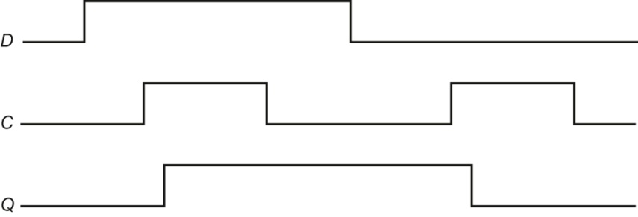
Figure A.8.3 Operation of a D latch, assuming the output is initially deasserted. When
the clock, C, is asserted, the latch is open and the Q output immediately assumes the value of the D input.
Copyright © 2021 Elsevier Inc. All rights reserved.

Slide 37
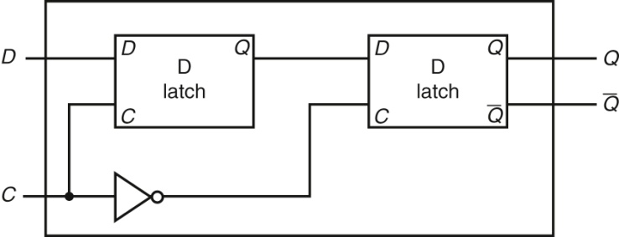
Figure A.8.4 A D flip-flop with a falling-edge trigger. The first latch, called the master, is open and
follows the input D when the clock input, C, is asserted. When the clock input, C, falls, the first latch is closed, but
the second latch, called the slave, is open and gets its input from the output of the master latch.
Copyright © 2021 Elsevier Inc. All rights reserved.

Slide 38
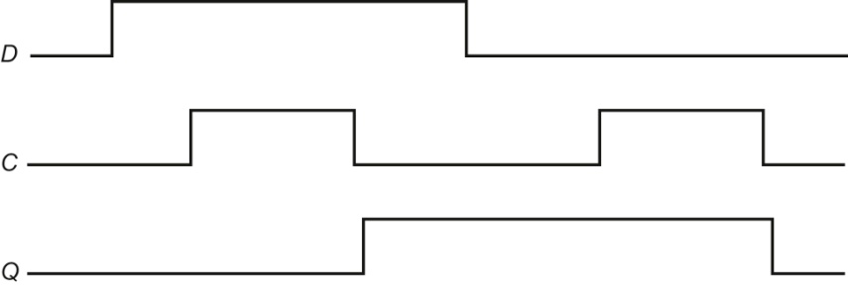
Figure A.8.5 Operation of a D flip-flop with a falling-edge trigger, assuming the output is
initially deasserted. When the clock input (C) changes from asserted to deasserted, the Q output stores
the value of the D input. Compare this behavior to that of the clocked D latch shown in Figure A.8.3. In a
clocked latch, the stored value and the output, Q, both change whenever C is high, as opposed to only when
C transitions.
Copyright © 2021 Elsevier Inc. All rights reserved.

Slide 39
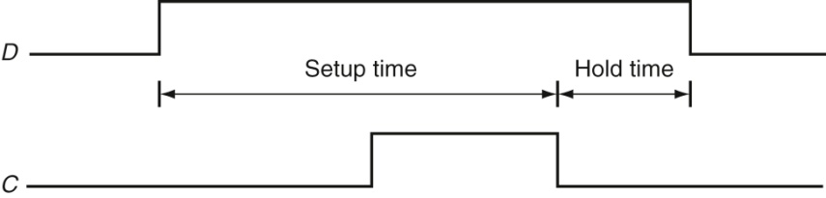
Figure A.8.6 Setup and hold time requirements for a D flip-flop with a falling-edge trigger.
The input must be stable for a period of time before the clock edge, as well as after the clock edge. The
minimum time the signal must be stable before the clock edge is called the setup time, while the minimum
time the signal must be stable after the clock edge is called the hold time. Failure to meet these minimum
requirements can result in a situation where the output of the flip-flop may not be predictable, as described
in Section A.11. Hold times are usually either 0 or very small and thus not a cause of worry.
Copyright © 2021 Elsevier Inc. All rights reserved.

Slide 40
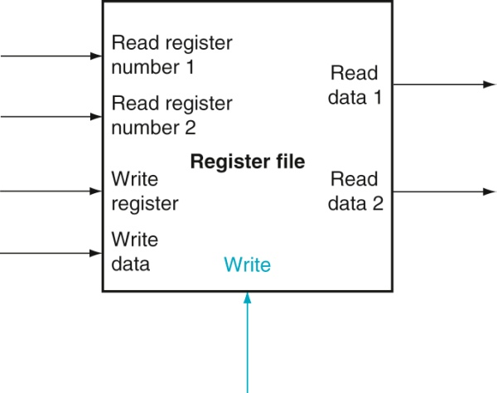
Figure A.8.7 A register file with two read ports and one write port has five inputs and
two outputs. The control input Write is shown in color.
Copyright © 2021 Elsevier Inc. All rights reserved.

Slide 41
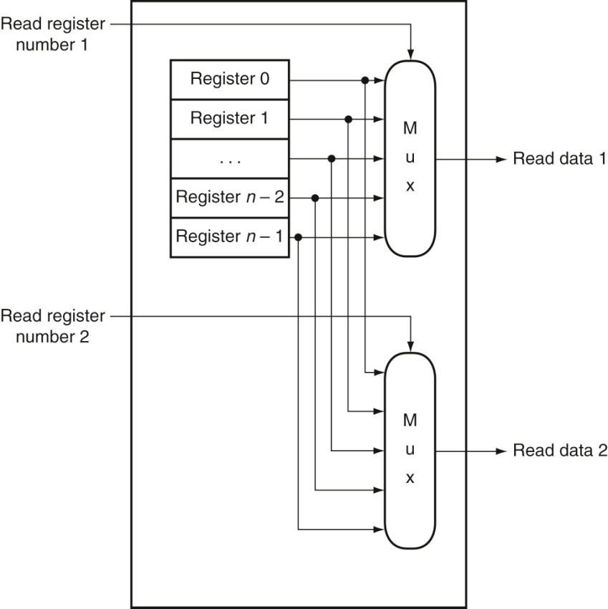
Figure A.8.8 The implementation of two read ports for a register file with n registers
can be done with a pair of n-to-1 multiplexors, each 32 bits wide. The register read number
signal is used as the multiplexor selector signal. Figure A.8.9 shows how the write port is implemented.
Copyright © 2021 Elsevier Inc. All rights reserved.

Slide 42
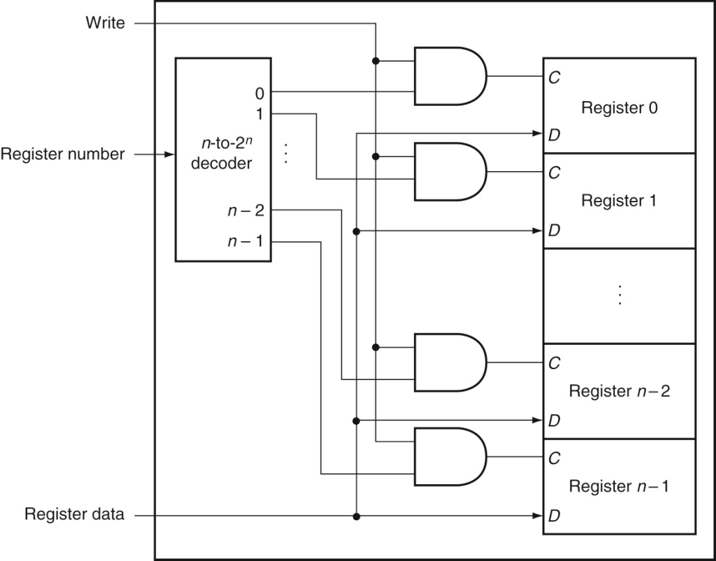
Figure A.8.9 The write port for a register file is implemented with a decoder that is used
with the write signal to generate the C input to the registers. All three inputs (the register
number, the data, and the write signal) will have setup and hold-time constraints that ensure that the correct
data are written into the register file.
Copyright © 2021 Elsevier Inc. All rights reserved.

Slide 43

Figure A.8.10 A specification of a clock.
Copyright © 2021 Elsevier Inc. All rights reserved.

Slide 44
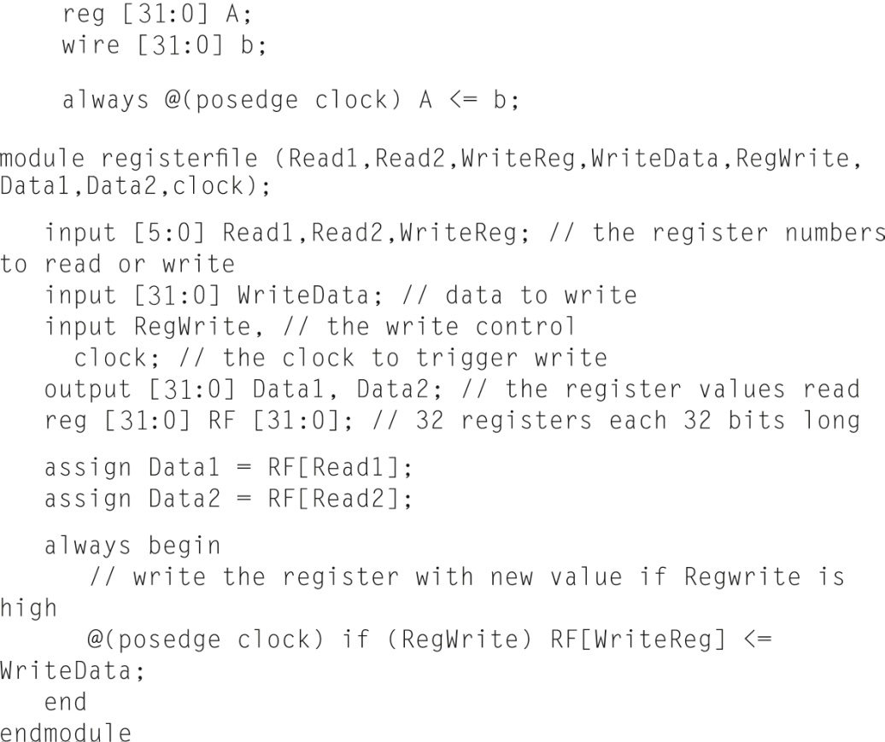
Figure A.8.11 A RISC-V register file written in behavioral Verilog. This register file writes on
the rising clock edge.
Copyright © 2021 Elsevier Inc. All rights reserved.

Slide 45
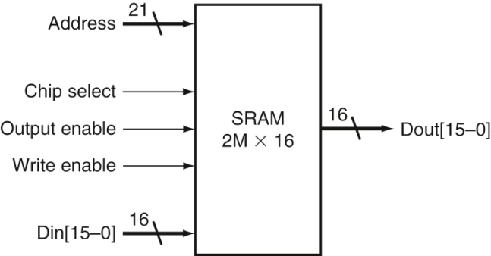
Figure A.9.1 A 32K × 8 SRAM showing the 21 address lines (32K = 215) and 16 data
inputs, the three control lines, and the 16 data outputs.
Copyright © 2021 Elsevier Inc. All rights reserved.

Slide 46
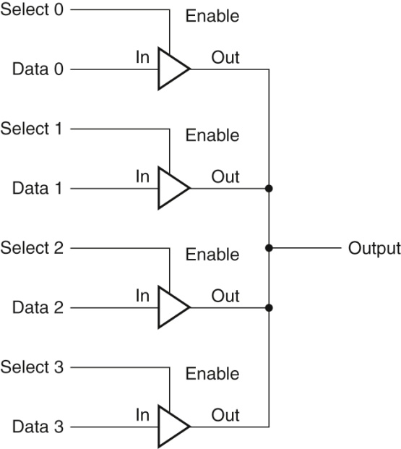
Figure A.9.2 Four three-state buffers are used to form a multiplexor. Only one of the four
Select inputs can be asserted. A three-state buffer with a deasserted Output enable has a high-impedance
output that allows a three-state buffer whose Output enable is asserted to drive the shared output line.
Copyright © 2021 Elsevier Inc. All rights reserved.

Slide 47
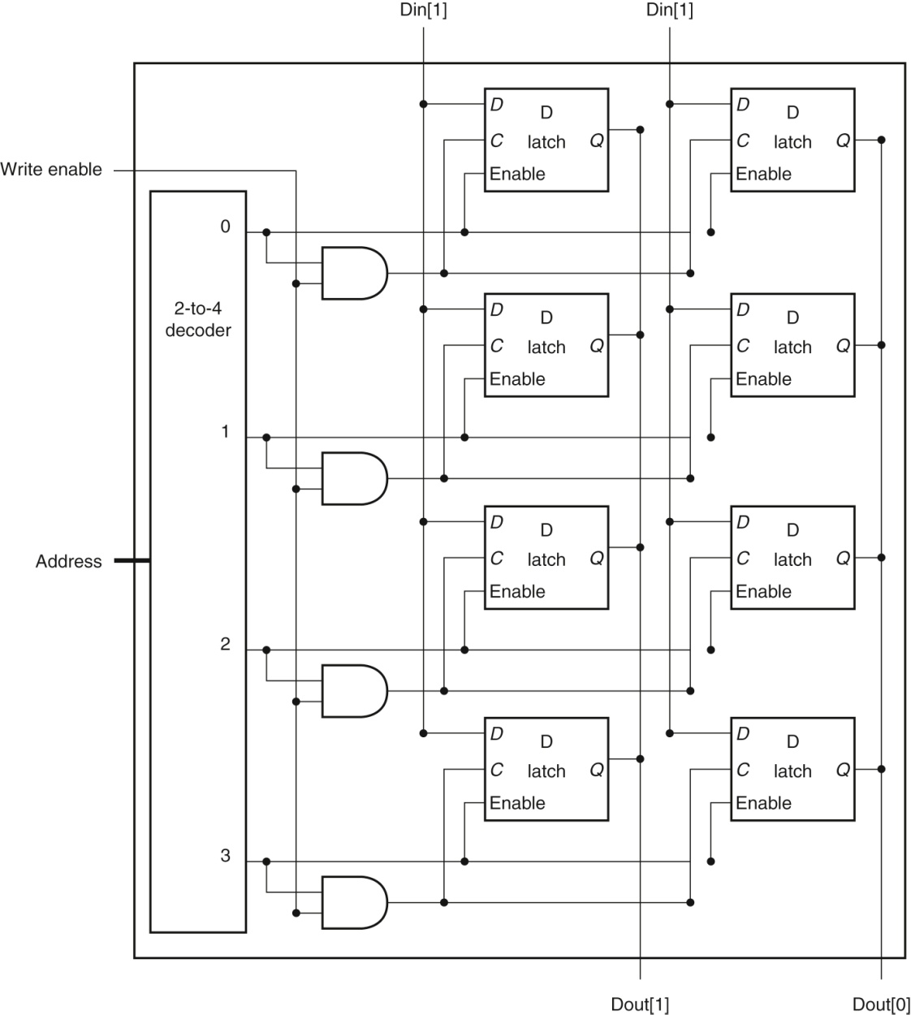
Figure A.9.3 The basic structure of a 4 × 2 SRAM consists of a decoder that selects which pair of cells to activate.
The activated cells use a three-state output connected to the vertical bit lines that supply the requested data. The address that selects the cell is sent on one of a set of horizontal address lines, called word lines. For simplicity, the Output enable and Chip select signals have been omitted, but they could easily be added with a few AND gates.
Copyright © 2021 Elsevier Inc. All rights reserved.

Slide 48
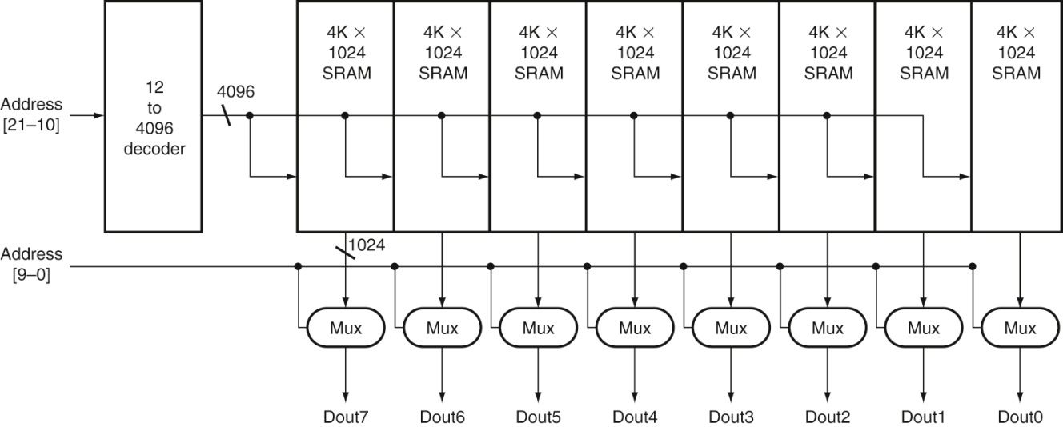
Figure A.9.4 Typical organization of a 4M × 8 SRAM as an array of 4K × 1024 arrays. The first decoder generates the
addresses for eight 4K × 1024 arrays; then a set of multiplexors is used to select 1 bit from each 1024-bit-wide array. This is a much easier design than a single-level decode that would need either an enormous decoder or a gigantic multiplexor. In practice, a modern SRAM of this size would probably use an even larger number of blocks, each somewhat smaller.
Copyright © 2021 Elsevier Inc. All rights reserved.

Slide 49
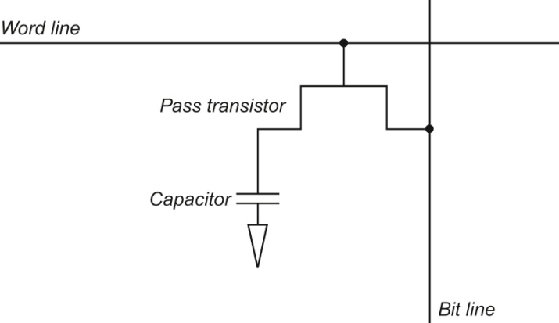
Figure A.9.5 A single-transistor DRAM cell contains a capacitor that stores the cell
contents and a transistor used to access the cell.
Copyright © 2021 Elsevier Inc. All rights reserved.

Slide 50
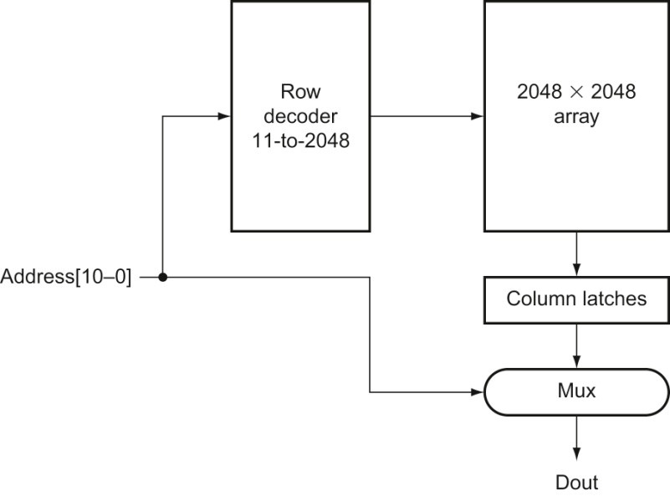
Figure A.9.6 A 4M × 1 DRAM is built with a 2048 × 2048 array. The row access uses 11 bits to
select a row, which is then latched in 2048 1-bit latches. A multiplexor chooses the output bit from these 2048
latches. The RAS and CAS signals control whether the address lines are sent to the row decoder or column
multiplexor.
Copyright © 2021 Elsevier Inc. All rights reserved.

Slide 51
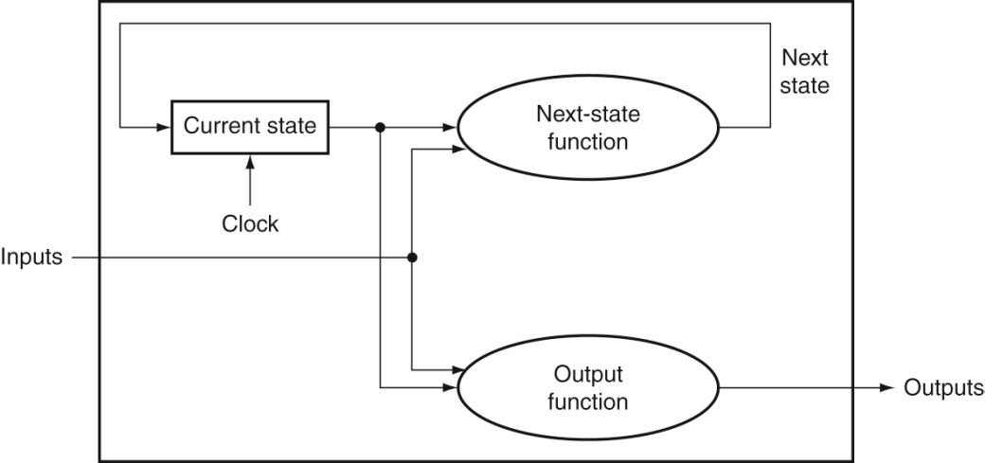
Figure A.10.1 A state machine consists of internal storage that contains the state and
two combinational functions: the next-state function and the output function. Often, the
output function is restricted to take only the current state as its input; this does not change the capability of
a sequential machine, but does affect its internals.
Copyright © 2021 Elsevier Inc. All rights reserved.

Slide 52
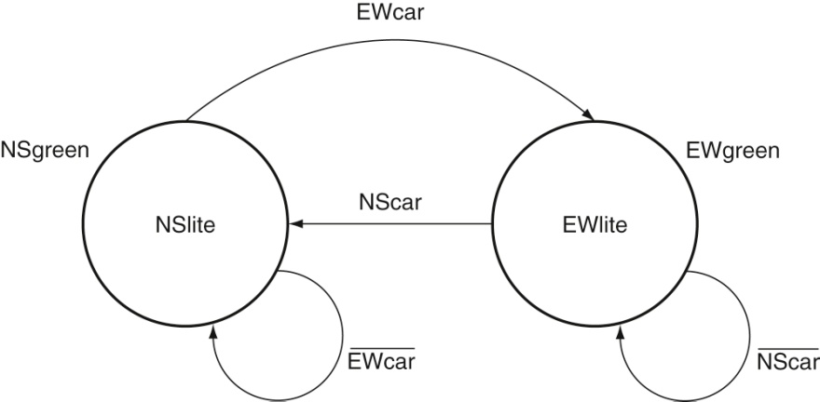
Figure A.10.2 The graphical representation of the two-state traffic light controller. We
simplified the logic functions on the state transitions. For example, the transition from NSgreen to EWgreen
in the next-state table is (NScar EWcar) (NScar EWcar), which is equivalent to EWcar.
Copyright © 2021 Elsevier Inc. All rights reserved.

Slide 53
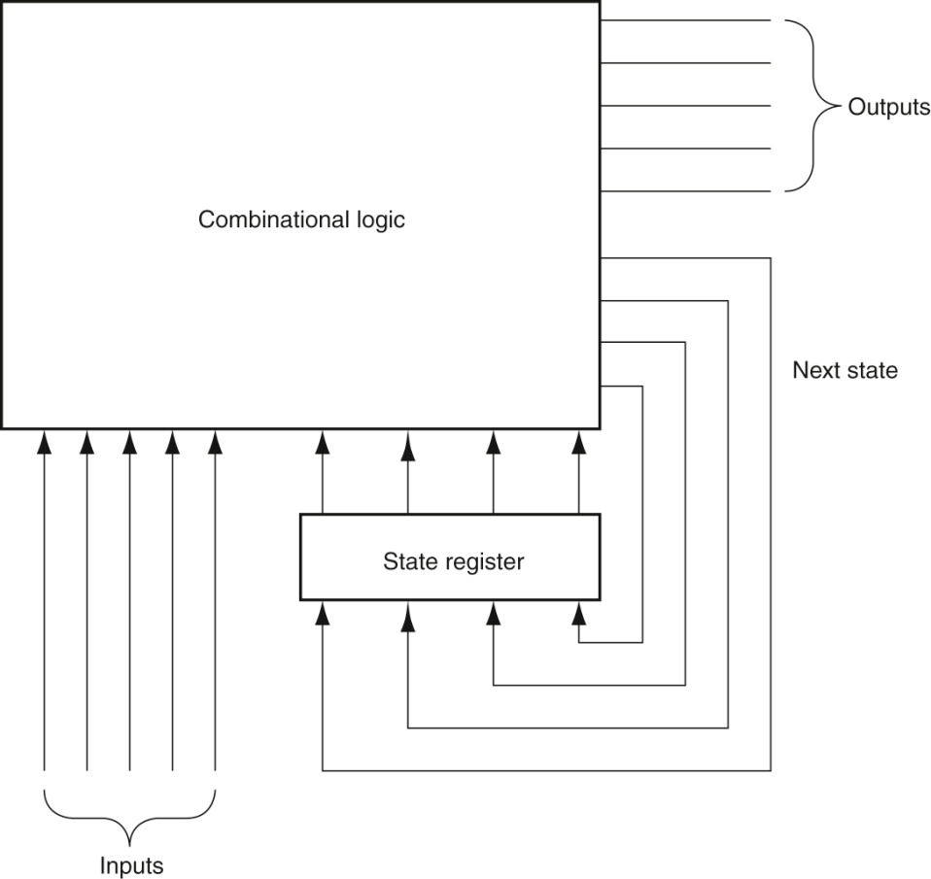
Figure A.10.3 A finite-state machine is implemented with a state register that holds
the current state and a combinational logic block to compute the next state and output
functions. The latter two functions are often split apart and implemented with two separate blocks of logic,
which may require fewer gates.
Copyright © 2021 Elsevier Inc. All rights reserved.

Slide 54

Figure A.10.4 A Verilog version of the traffic light controller.
Copyright © 2021 Elsevier Inc. All rights reserved.

Slide 55

Figure A.11.1 In an edge-triggered design, the clock must be long enough to allow
signals to be valid for the required setup time before the next clock edge. The time for a
flip-flop input to propagate to the flip-flip outputs is tprop; the signal then takes tcombinational to
travel through the combinational logic and must be valid tsetup before the next clock edge.
Copyright © 2021 Elsevier Inc. All rights reserved.

Slide 56

Figure A.11.2 Illustration of how clock skew can cause a race, leading to incorrect operation. Because of the difference
in when the two flip-flops see the clock, the signal that is stored into the first flip-flop can race forward and change the input to the second flipflop before the clock arrives at the second flip-flop.
Copyright © 2021 Elsevier Inc. All rights reserved.

Slide 57

Figure A.11.3 A two-phase clocking scheme showing the cycle of each clock and the
nonoverlapping periods.
Copyright © 2021 Elsevier Inc. All rights reserved.

Slide 58
Figure A.11.4 A two-phase timing scheme with alternating latches showing how the system operates on both clock
phases. The output of a latch is stable on the opposite phase from its C input. Thus, the first block of combinational inputs has a stable input during ϕ2, and its output is latched by ϕ2. The second (rightmost) combinational block operates in just the opposite fashion, with stable inputs during ϕ1. Thus, the delays through the combinational blocks determine the minimum time that the respective clocks must be asserted. The size of the nonoverlapping period is determined by the maximum clock skew and the minimum delay of any logic block.
Copyright © 2021 Elsevier Inc. All rights reserved.

Slide 59

Figure A.11.5 A synchronizer built from a D flip-flop is used to sample an asynchronous
signal to produce an output that is synchronous with the clock. This “synchronizer” will not
work properly!
Copyright © 2021 Elsevier Inc. All rights reserved.

Slide 60

Figure A.11.6 This synchronizer will work correctly if the period of metastability that
we wish to guard against is less than the clock period. Although the output of the first flip-flop
may be metastable, it will not be seen by any other logic element until the second clock, when the second D
flip-flop samples the signal, which by that time should no longer be in a metastable state.
Copyright © 2021 Elsevier Inc. All rights reserved.

Slide 61

Copyright © 2021 Elsevier Inc. All rights reserved.

Slide 62

Figure A.14.1 Traditional ripple carry and carry save addition of four 4-bit numbers. The
details are shown on the left, with the individual signals in lowercase, and the corresponding higher-level
blocks are on the right, with collective signals in upper case. Note that the sum of four n-bit numbers can
take n + 2 bits..
Copyright © 2021 Elsevier Inc. All rights reserved.

